Slide 1

Analysis Of AMCAT Data

Slide 2
About me:
As an engineering graduate in Electrical and Electronics Engineering (EEE), I have developed a strong foundation in analytical thinking and problem-solving. Recently, I have expanded my expertise into data science and machine learning, driven by a passion for uncovering insights from data. I have gained knowledge in statistical analysis, data visualization, and machine learning algorithms. While I have yet to work on professional projects, I am eager to apply my skills in real-world situations and am committed to continuous learning and growth in the field of data science.
Education:
Bachelor Of Technology(B.Tech)
Department: Electrical and Electronics Engineering
Passedout Year: 2023
Linkedin Profile: www.linkedin.com/in/srija-valluri

Slide 3
Business Problem and Use case domain understanding:
The project analyses employment outcomes for engineering graduates, focusing on salary, job, titles,
and locations.
Data includes standardized scores in cognitive, technical, and personality traits, as well as demographic
information.
Key business problem: Predict salaries using a combination of academic and demographic data.
Objective Of The Project:
Salary Prediction Models: Build a predictive model for salary estimation based on variables like
academic performance and standardized scores.
Data-driven salary targeting initiative: Aim to optimize salary decisions using data to reflect internal
performance and industry trends.

Slide 4
Summary Of Data:
40 independent variables with 4,000 data points.
Key variables: Salary (dependent variable), all other variables are (independent), along with demographic details.
Exploratory Data Analysis
Data Cleaning Steps:
Column Names Standardization
Fixing Columns
Fixing Data type
Handling Missing Data
Identification and Treatment of Outliers

Slide 5
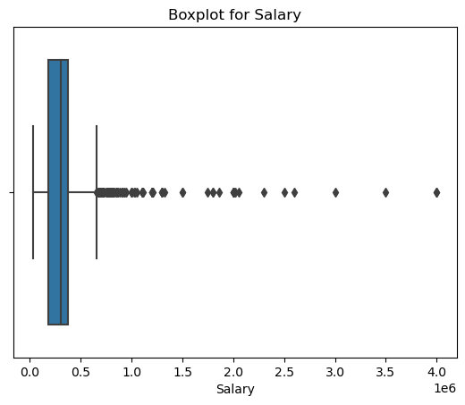
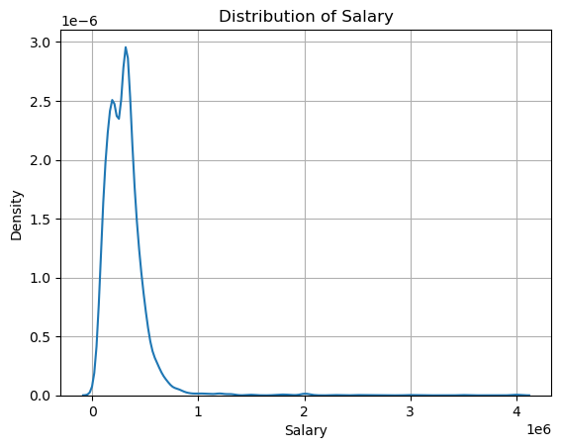
Univariate Analysis
Univariate analysis explores a single variable to understand its distribution, central tendency (mean, median), and variability (range, standard deviation).
The data shows a concentration of salaries between the ranges.
KDE plots and histograms are used to examine salary distribution.
Boxplots help to identify salary outliers​

Slide 6
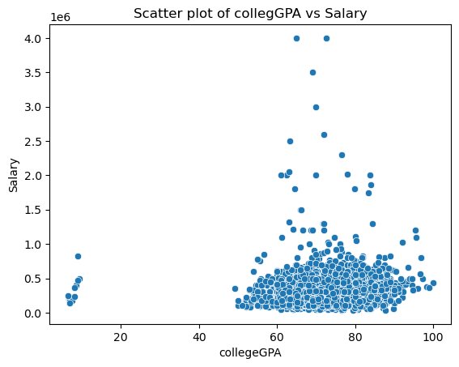
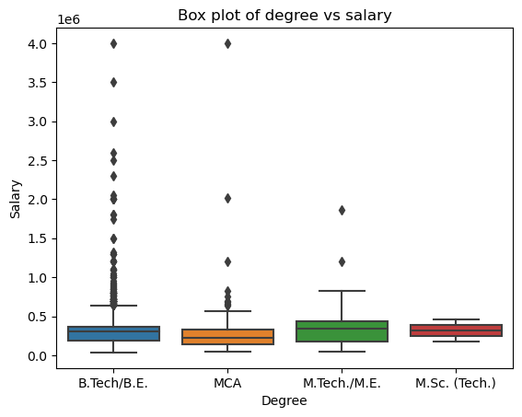
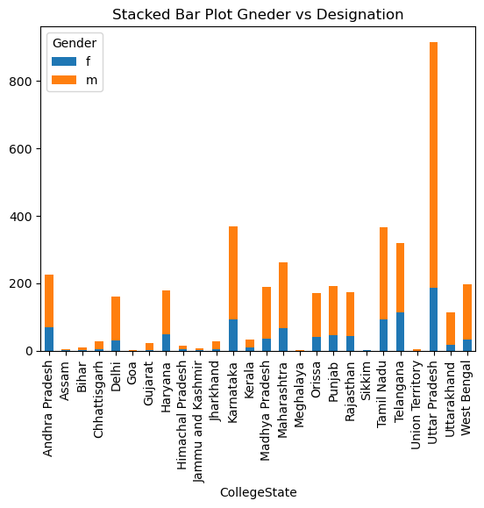
Bivariate Analysis
Bivariate analysis examines the relationship between two variables, such as numerical or categorical data pairs.
Scatter plots are used to observe relationships in numerical vs numerical.
Box plots help to compare numerical vs categorical.
Stacked bar plots are used to observe categorical vs categorical.

Slide 7
Research Questions:
Explore the relationship between gender and specialization.
Validate the claim from the times of India regarding salary expectations for specific job roles.
Conclusion:
Salary Distribution: Most salaries are concentrated between ₹100,000 and ₹300,000, with fewer high-paying roles above ₹300,000.
Top Specializations: Electronics and Communication Engineering has the highest number of graduates, followed by Computer Science.
Location Insights: Bangalore is the leading job city for these roles.
Significant Relationships: There is a significant difference between salary expectations for specific job roles and the claimed mean, and a notable relationship between gender and specialization.
These findings provide valuable information for understanding salary trends, career paths, and demographic influences.

Slide 8

THANK YOU

